Slide 1



Applying to Cambridge
Mr Scott Mandelbrote
Admissions Tutor for Arts
Peterhouse, Cambridge

Slide 2


Why Oxford or Cambridge?
Challenging academic degrees
Assessment largely through exams
8 week terms
Unique supervision teaching
Focus on independent study and learning
Notes:
Very little coursework
C.f. 10 week terms – quite intense/long holidays for working, studying, travel
levels of teaching – lectures, seminars, supervisions
Supervisions are big selling point – independent to lectures in many arts subjects

Slide 3
The UK has voted to leave the European Union
It is not currently known how long that process will take or the impact that it will have on UK policy on higher education tuition fees, loans and bursaries.
The University of Cambridge can confirm that undergraduate EU students who are already studying at Cambridge, who have an offer to study at Cambridge, or who apply in 2016 to start their studies in 2017, will continue to be charged the UK fee rate applicable at the time, provided this continues to be permitted by UK law. Please note that the UK fee rate may be subject to increases, which may be annual.
The fees for all applicants, including Home/EU students, considering entry in 2018 (including deferred entry from 2017), have yet to be set.

Slide 4
Typical Cambridge offers
Offers generally conditional on academic performance in exams
Overall score of 8.0 - 8.5 (goed) and 9.0 (zeer goed) in up to three subjects
Possible STEP condition (Maths, Computer Science, Engineering)
English language requirement – IELTS normally a minimum overall grade of 7.5, usually with 7.0 or above in each element (sciences), 8 or 8.5 usually with 7.0 or above in each element (arts)

Slide 5
Typical Cambridge offers
Looking for you to be on target for typical conditions
No quotas or cut-offs
All offers are made on a case-by-case basis
  Take all available information into account – holistic
  No particular weighting applied to any one piece of information

Slide 6
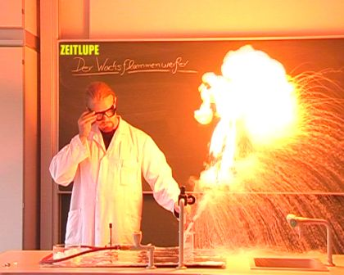
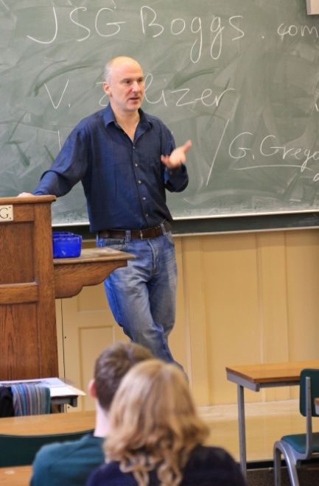

Choosing a course
What do I like?
What am I good at?
Am I taking the necessary A level/IB subjects?
How is the course structured/taught (what/how will I learn)?
Notes:
6
Choose course over university
Consider how it is taught – independent reading for English c.f. practicals for science
Consider course structure e.g. NatSci – broad to specific, education – like a dual degree
Course names can be deceptive (e.g. NatSci) – look closer

Slide 7


3 ways that Cambridge is different…
Teaching Style
Colleges
Application Process
Notes:
7
Courses regularly top numerous league tables
Expert teaching staff – many national and world subject leaders
Significant contact time through tutorials/supervisions
Among highest graduate employment rates in the UK - students develop a strong range of transferable skills useful in any career and greatly sought after in any sector, employers know how good our graduates are!

Slide 8
Teaching
Notes:
8

Slide 9
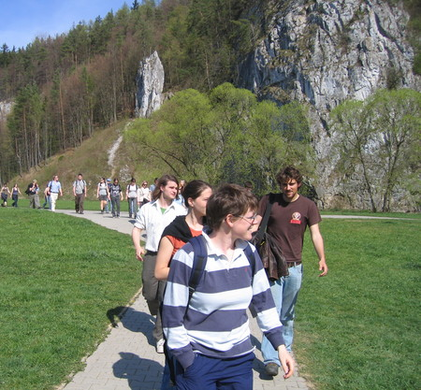



Teaching styles at university
Notes:
9
AVAILABLE AT ALL UNIS
Fieldwork
Independent Study
Classes
Lectures
Labwork

Slide 10

Additional teaching style at Cambridge
A supervision
Notes:
10
WHAT MAKES OXBRIDGE DIFFERENT
Supervisions – DoSes, Tutors, personal attention, selfish learning
No resits – assessment is mainly through end of year exams

Slide 11
Colleges
Notes:
11

Slide 12



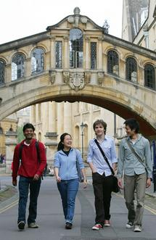
The University and its Departments
As a student, you’re a member of the University, a department and a College
The University and its departments provide:
  Course content
  Lectures, seminars, practicals and projects
  Assessments and exams
  Award degrees
  Careers advice
Notes:
Who does what – the Universities
Students are members of the University and their College
Universities – determine course content; organise lectures, seminars, practicals (where relevant) and projects; set and mark examinations; award degrees
Universities’ Careers Services – available to students while at the University but also after graduation; range of services such as skills training, careers events, alumni networks as well as advice on career options, vacation placements and job applications.

Slide 13


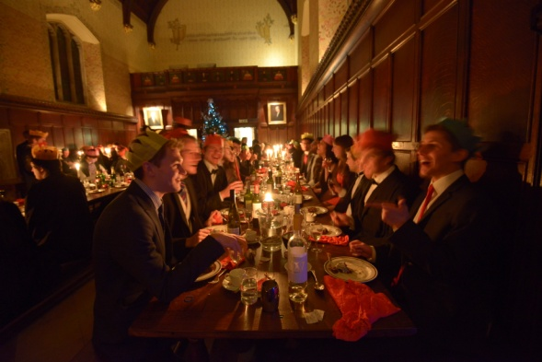
Colleges
~25 undergraduate Colleges
Your home within Cambridge!
        Accommodation
        Common Room
        Dining Hall
        Library
        Sports facilities
        Support network
Most subjects available at most Colleges
Notes:
13
Students are members of both their College and the University
Colleges responsible for admitting students – apply to the University through a College
College decides whether or not to make you an offer and, if so, what that offer will be but it’s the University that awards degrees at the end of studies
Colleges:
are students’ primary community
provide accommodation (halls of residence)
are centres of social life (‘mini campus’) – lots of social activities and facilities to use at very low cost/free
are responsible for organising tutorials/supervisions (not always with tutors/supervisors at own College – where a relevant subject specialist is based at another College, will go to them for some tutorials/supervisions)
29 undergraduate Colleges at Cambridge, 30 at Oxford

Slide 14
Choosing a College
More alike than different
Department-based teaching
Most subjects available at most Colleges
Personal preferences
        Size
        Style
        Location
        Accommodation
Open application
Notes:
14
Whatever your College, the lectures you go to, the coursework you do and exams you sit will be exactly the same
Entry requirements are broadly similar across all Colleges but there may be differences in subject preferences and arrangements before and at interview – no Colleges are ‘easier’ to get into
Colleges are more alike than they are different – differences are in ambiance, not educational opportunities
Think of choosing a College in terms of choosing a home – what sort of environment, facilities, accommodation options most appeal to you?

Slide 15
Application process
Notes:
15

Slide 16
Application process: timeline
Choose course
Choose a College or open application
UCAS application
15 Oct
+ SAQ (Cam)
22 Oct
1 in 5
applicants made an offer (on average)
Admissions test? Check registration deadline
Written work and/or admissions test
Decision
(Jan)
Interviews
(Dec)
Notes:
16

Slide 17
SAQ
Cambridge-specific
Space for optional additional personal statement to address Cambridge course
Completed online
Ensures we have full and accurate information
  UMS marks if available
  Topics covered at school
  Opportunity to explain any teaching difficulties

Slide 18
Extenuating Circumstances
If your education has been affected by circumstances outside of your control
We want to to assess your achievements in the proper context
  Ask your teacher/doctor/lawyer to submit an Extenuating Circumstances Form on your behalf

Slide 19
Admissions Assessments
Further opportunity to impress
  Some pre-interview, others at interview, none in Maths and Music
Aptitude-based, no prior knowledge required
Support selection of candidates for interview and offers

Slide 20


Written work
Depends on subject
Most commonly a piece of work completed as part of sixth form studies (some colleges set a question)
We encourage applicants to re-read their essays and think about the marker’s comments
The most effective submitted work tends to be that which applicants are likely to enjoy discussing and which has been completed relatively recently
Won’t generally form part of selection process ahead of interview at Peterhouse
NB: work should not be prepared for the purpose of applying!

Slide 21

Selection criteria
A level predictions
GCSE grades
Teacher reference
Personal statement
Interviews
Written work (where required)
Admissions assessments (where required)
UMS scores (if available)
SAQ
Contextual information
All UK universities

Slide 22

Interviews: what to expect
1, 2 or 3 interviews – all academic
Conducted by lecturers
May also be set a test/interview prep
Likely topics of discussion:
  Submitted work/personal statement
  Current schoolwork (and how you have gone beyond it)
  Problem-solving
  Something you’ve never seen before
Notes:
22

Slide 23

Interviews: some advice
No special preparation required or expected
Remind yourself of what we know about you
Use your personal statement to show yourself off
Value your own opinion – speak up
Don’t panic when you get stuck
  Check your working/thinking
  Listen to hints
  Try a different approach
Watch videos of interviews
Try to relax and enjoy it!
Notes:
23
Re-read submitted written work/personal statement/school work so far
This is an opportunity for you to see how the supervision teaching style suits you
You WILL get stuck. Take the time to check over your work/argument.
Try to enjoy it – let them see that you are excited about the course
Interviews in Action – horribly cheesey, but gives you an idea of how it’ll go

Slide 24
The Winter Pool
Moderation process for Cambridge
Ensures all applicants have equal chance of admission to the University
Early January – may be called for re-interview, may receive offer outright
Typically around 3,300 applicants offered directly and a further 800ish from pool (from c. 16,000 applicants)1
1 Stats for 2015

Slide 25

The Winter Pool
Notes:
Discuss!

Slide 26
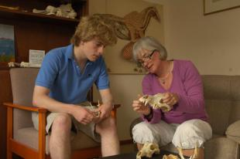
What are we looking for?
Independent thinking and intellectual flexibility
Communication skills
Teachability/suitability for the course
Potential rather than achievements
Solid (not necessarily impeccable) school record that matches the subject-specific selection criteria
Notes:
26

Slide 27
Successful Applications
Key points for success
Strong exam results
Choice of subject
Wider reading
Some revision in advance of interview
Willing to engage in discussion
Common pitfalls
Wrong degree subject chosen
Unsuitable A-level choices, too many subjects in Year 12 or low grades
Inconsistent reference
Lack of wider reading and critical engagement
Lack of revision before interview
Rehearsed answers at interview, lack of clarity or flexibility of thought
Notes:
Need to emphasise that it’s a competition – students can be excellent and still not get a place.

Slide 28
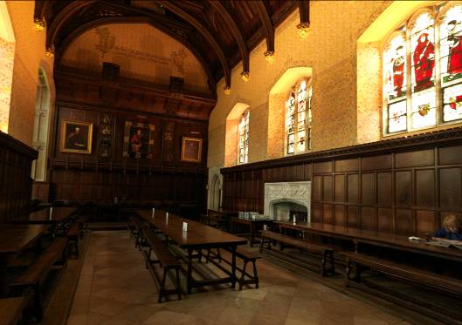
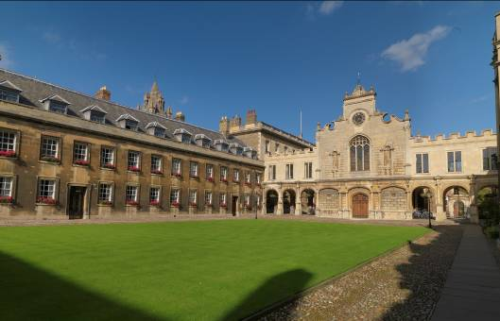


Find out more: contact us
Peterhouse Admissions Office
01223 338223
admissions@pet.cam.ac.uk
www.pet.cam.ac.uk
@Peterhouse_SLO
The Student Room threads this summer
Or there is time for lots of questions today
Notes:
28

Slide 29
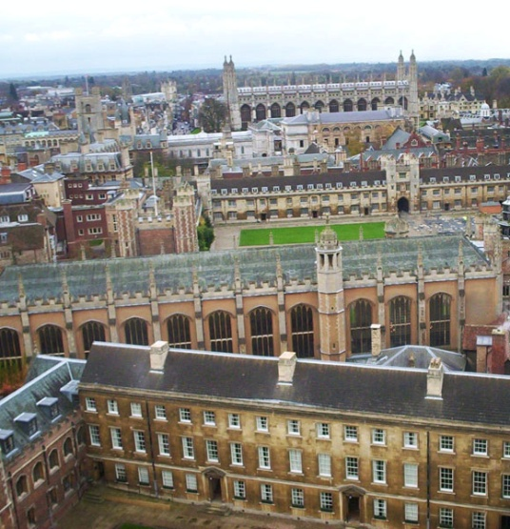
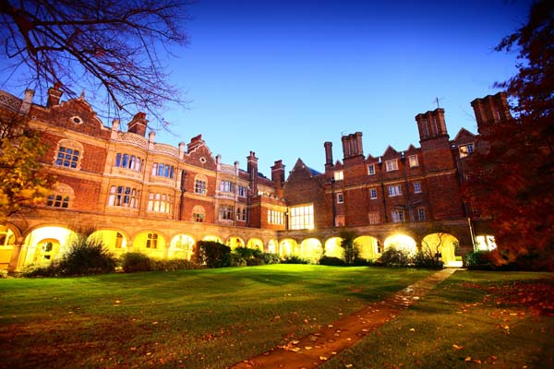
Frequently Asked Questions
Can I apply to both Oxford and Cambridge?
How does Cambridge view exam resits?
Is there a minimum GCSE requirement?
What is the typical offer at Cambridge?
Which Colleges are better for which subjects?
Does my choice of College affect my chance of entry to the University?
What extra-curricular activities will help my chances of admission?
Notes:
29
Exam resits:
Recognise even very capable students may have ‘bad days’ when an exam doesn’t go to plan
A student’s application unlikely be adversely affected by their resitting one or two modules
However, would be concern about student’s potential to be successful at Oxford/Cambridge if they need resit numerous exams, particularly where only marginal improvement achieved
Minimum GCSE requirement:
Only GCSE requirements for Medicine (both), Biomedical Sciences (Ox), Vet Med (Cam)
Would expect GCSEs in subjects most relevant to course applied for to be strongest
GCSEs looked at but in context of the school’s performance
Colleges and subjects:
Universities determine course content
Students from all Colleges on same course attend same lectures, classes, seminars, practicals together
Therefore, no Colleges ‘better’ for any subjects
Typical offer:
Arts/Humanities/PBS - A*AA
Sciences (exc. PBS) - A*A*A as of 2015 entry
IB 40-42 overall, 7,7,6-7,7,7 HL
Maths 1,1 @ STEP II & III
Colleges easier to get in to:
Entry requirements broadly the same across all Colleges – for Cam, only differences may be in subject preferences and/or arrangements before or at interview. Ox – admissions requirements and process same for all colleges, and candidates are likely to be interviewed at more than one, in any case
Extensive moderation across Colleges and subjects ensures all assessing to same standards
Therefore, mistake to think some Colleges may be ‘easier’ to get in to
Admissions statistics show that, for equally well-qualified students, College/open application choice makes no difference to chances of being offered a place
Extra-curricular activities
Admissions decisions based on academic criteria (ability and potential)
Participation (or not) in specific extra-curricular activities isn’t taken into account (unless relevant to the course applied for) and doesn’t affect chances being made an offer
However, should consider importance that other university choices may place on extra-curricular activities when composing personal statement

